Slide 1
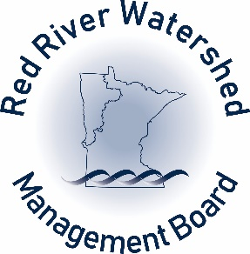
Red River Watershed Management Board Flood Damage Reduction Efforts and Activities
A Presentation to the
LCC Subcommittee on Minnesota Water Policy
December 18, 2019
St. Paul, MN
Robert L. Sip, Executive Director
Red River Watershed Management Board

Slide 2
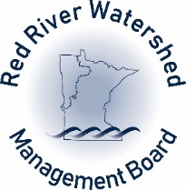
Discussion Items
Red River Watershed Management Board (RRWMB) Overview
Current RRWMB Activities and Flood Damage Reduction Projects
Red River Basin (MN) Funding Needs and Process
Investments Made in the Red River Basin
2019 Flooding
Current Issues and Conditions
Funding Needs

Slide 3
RRWMB Overview
RRWMB is a joint powers agreement entity comprised of seven watershed districts and was formed in 1976 by the Minnesota Legislature.
The RRWMB has taxing authority – 0.04836 percent of the taxable market value of all property within the member watershed districts.
Mission - To institute, coordinate, and finance projects and programs to alleviate flooding and assure the beneficial use of water in the watershed of the Red River of the North and its tributaries.

Slide 4
Principal and Supporting Objectives
Assist member Watershed Districts with the implementation of water related projects and programs. The purpose of these projects and programs is the reduction of local and mainstem flood damages, and also to enhance environmental and water resource management. Projects and programs must be of benefit to the Red River Basin and its member watershed districts in order to qualify for RRWMB funding.
Coordination
Financial Support
Basin Planning
Water Quantity
Water Quality
Erosion and Sedimentation
Education
Research
Public Information
Conflict Resolution
Policies, Rules, and Regulations of Other Entities

Slide 5
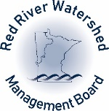
Counties Partially or
Fully Within the RRWMB
Becker County
Beltrami County
Big Stone County
Clay County
Clearwater County
Grant County
Itasca County
Kittson County
Koochiching County
Lake of the Woods County
Mahnomen County
Marshall County
Norman County
Otter Tail County
Pennington County
Polk County
Red Lake County
Roseau County
Stevens County
Traverse County
Wilkin County
Notes:
Who are members?

Slide 6
2020 Budgetary Information

Slide 8
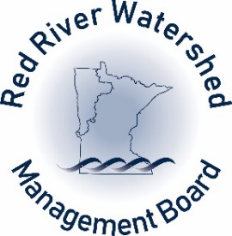
Annual Programs Funded by the RRWMB (2019 Information)
$125,000 | International Water Institute River Watch Program
$32,000 | Red River Retention Authority
$85,000 | Red River Basin Commission
$118,535 | USGS Stream Flow Monitoring
$360,535 | Total:

Slide 9
Current RRWMB Funding Commitments

Slide 10
State Share Request
State Share Request

Slide 11
Projected Funding (Non-state): FY 2020 to FY 2024
WD - Project | RRWMB Commitment | WD | Other | Federal | Totals
Totals | $34,555,667 | $21,576,000 | $15,365,000 | $3,000,000 | $74,496,667

Slide 12
Current Statewide Funding Needs
$293,739,520 – Current known funding needs as of September 30, 2019 for all project types (MN DNR Data).

Slide 13
Potential Allocation of 2020 Flood Hazard Mitigation Grant Funding and 2018 Grants Awarded
2018 Funds Allocated: Afton, Austin, Chanhassen, Golden Valley, Halstad, Hendrum, Montevideo, Moorhead, Roseau Lake Bottom, and Thief River Falls
2020 Funding Priorities: Afton, Austin, Breckenridge, Carver, Cedar River Watershed, Faribault, Golden Valley, Jordan, Montevideo, Moorhead, Red River Impoundments (Roseau Lake Bottom) and Waseca

Slide 14
Data From MN DNR – August 2019

Slide 15
August 1, 2019

Slide 17
Red River Basin Funding Process
RRWMB:
Step Process
Star Valuation
Project Evaluation Worksheet
Funding Commitment
Technical Review
1998 Red River Basin Flood Mediation Agreement:
Flood Damage Reduction Work Group:
Project Team Handbook
Project Team Support
Project Acceleration Grants
Technical Review and Guidance (14 Technical Papers)
Letter of Support of Projects to MN DNR
Local Watershed District - Project Concept, Project Alternatives, Planning, Design, Engineering, Permitting, Environmental Review, Construction, Operation, and Maintenance
Bonding, Flood Hazard Mitigation Program, LSOHC, and Other Sources

Slide 18
Investments Made in the Red River Basin
Regional Flood Control – Over 40 Projects Completed Since 1976
Rural Ring Dike Program – Over 270 Ring Dikes Constructed Since 1997
USGS Stream Gauge Program
Technical Efforts – Hydrology/Hydraulics Modeling and Studies
Education and Outreach – River Watch Program

Slide 19
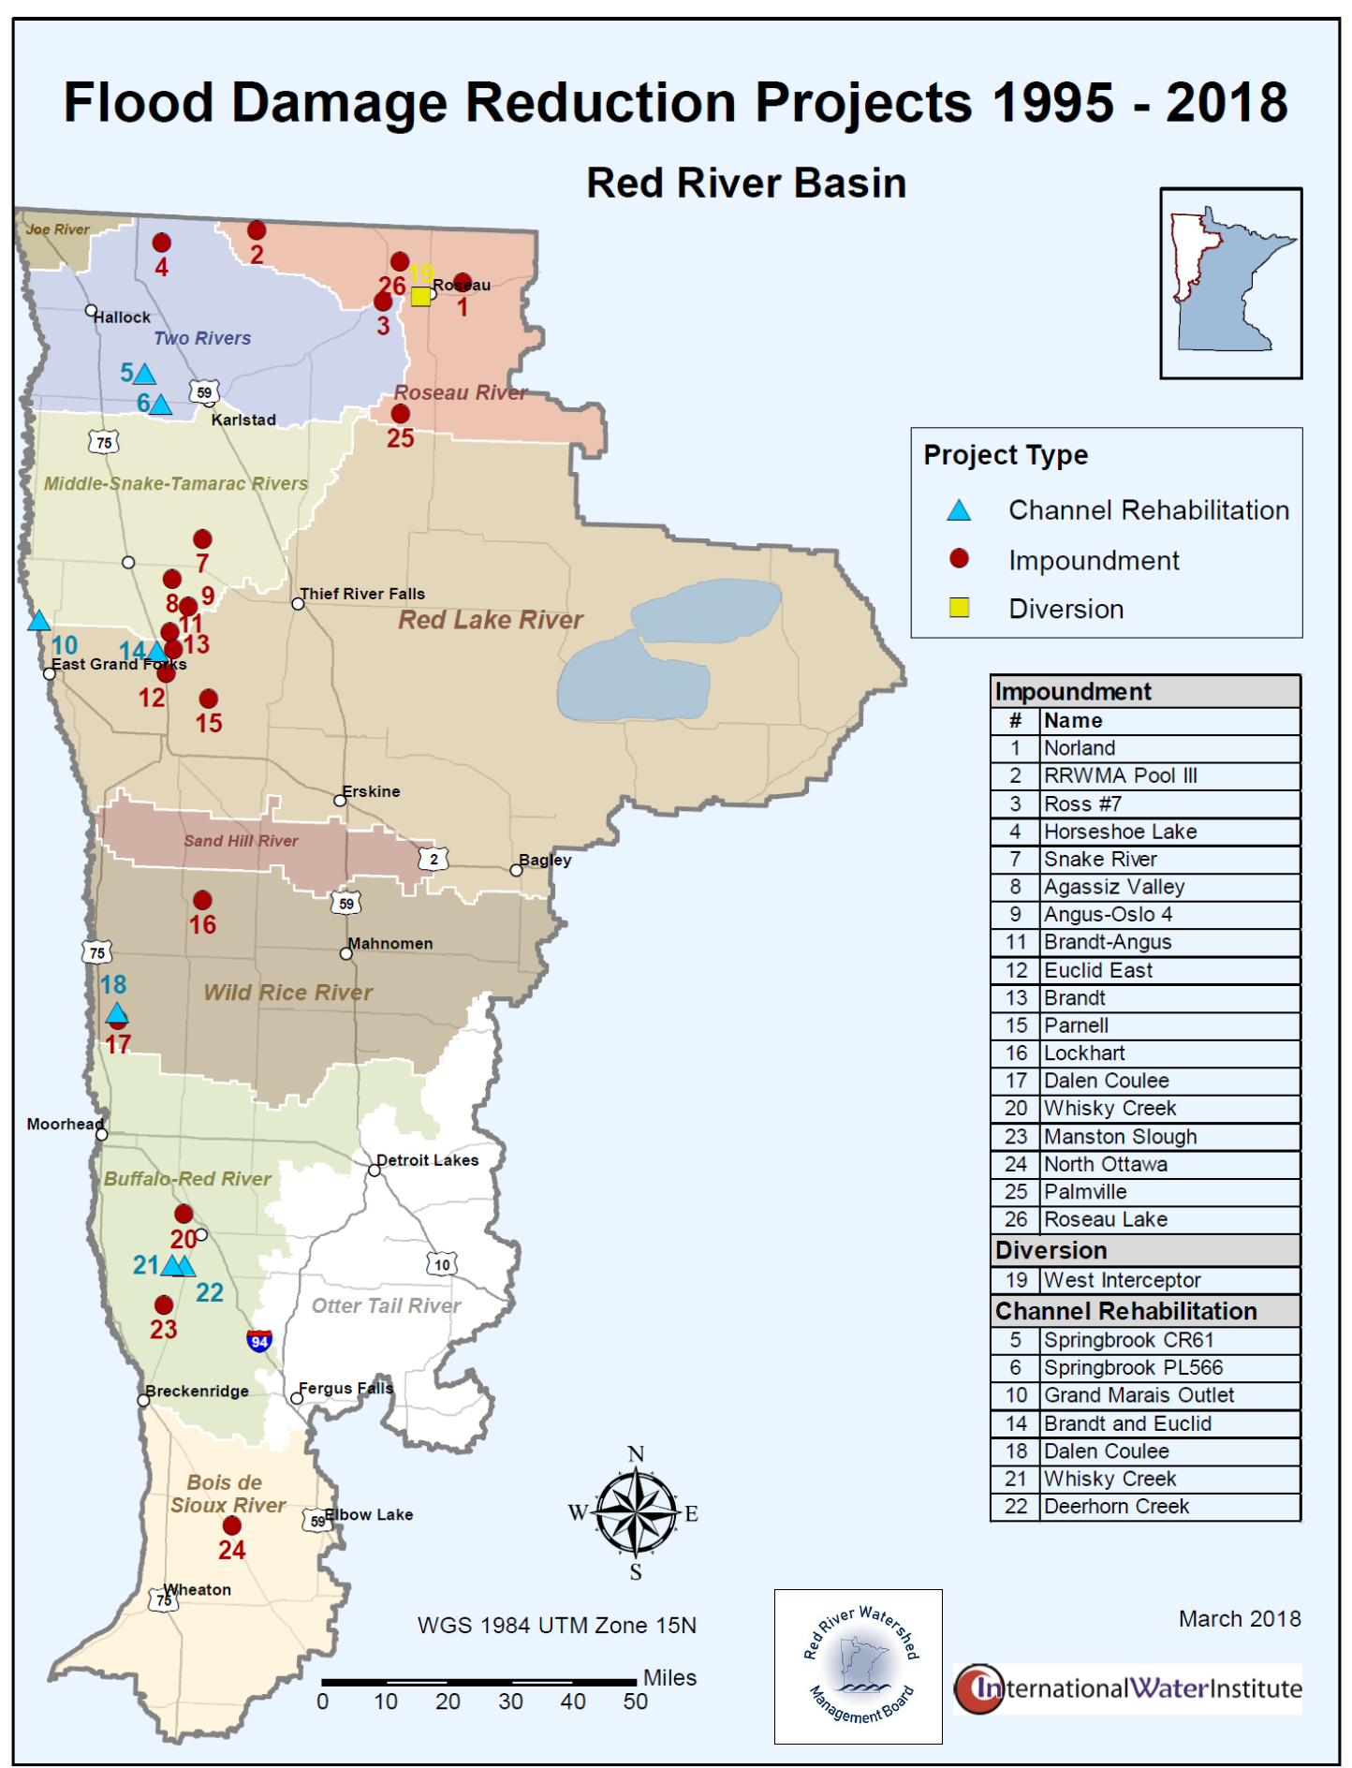
The RRWMB is currently updating this map to reflect projects prior to 1995.

Slide 20
Benefits of State Investments in the Red River Basin
Flood Mitigation Projects Enhance Local and Regional Economic Vitality
Protection of Public Investments:
City Streets, Sewer, and Water Infrastructure
Township, County, and State Highways, Roads, Bridges, and Culverts
Drainage Systems
Protection of Private Investments:
On-farm Infrastructure
Farmland 10 and 25-year Storm Events
Non-city Residents and Developments
Recreational, Water Quality, and Habitat Benefits – Natural Resources Enhancements (NREs)

Slide 21
NWS - March 15, 2019

Slide 27
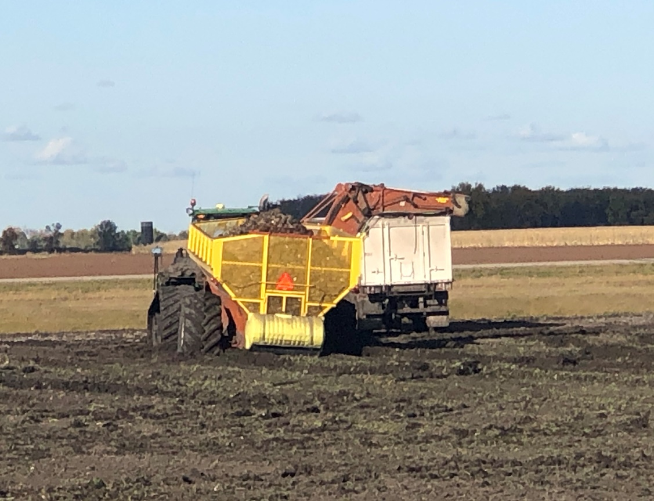
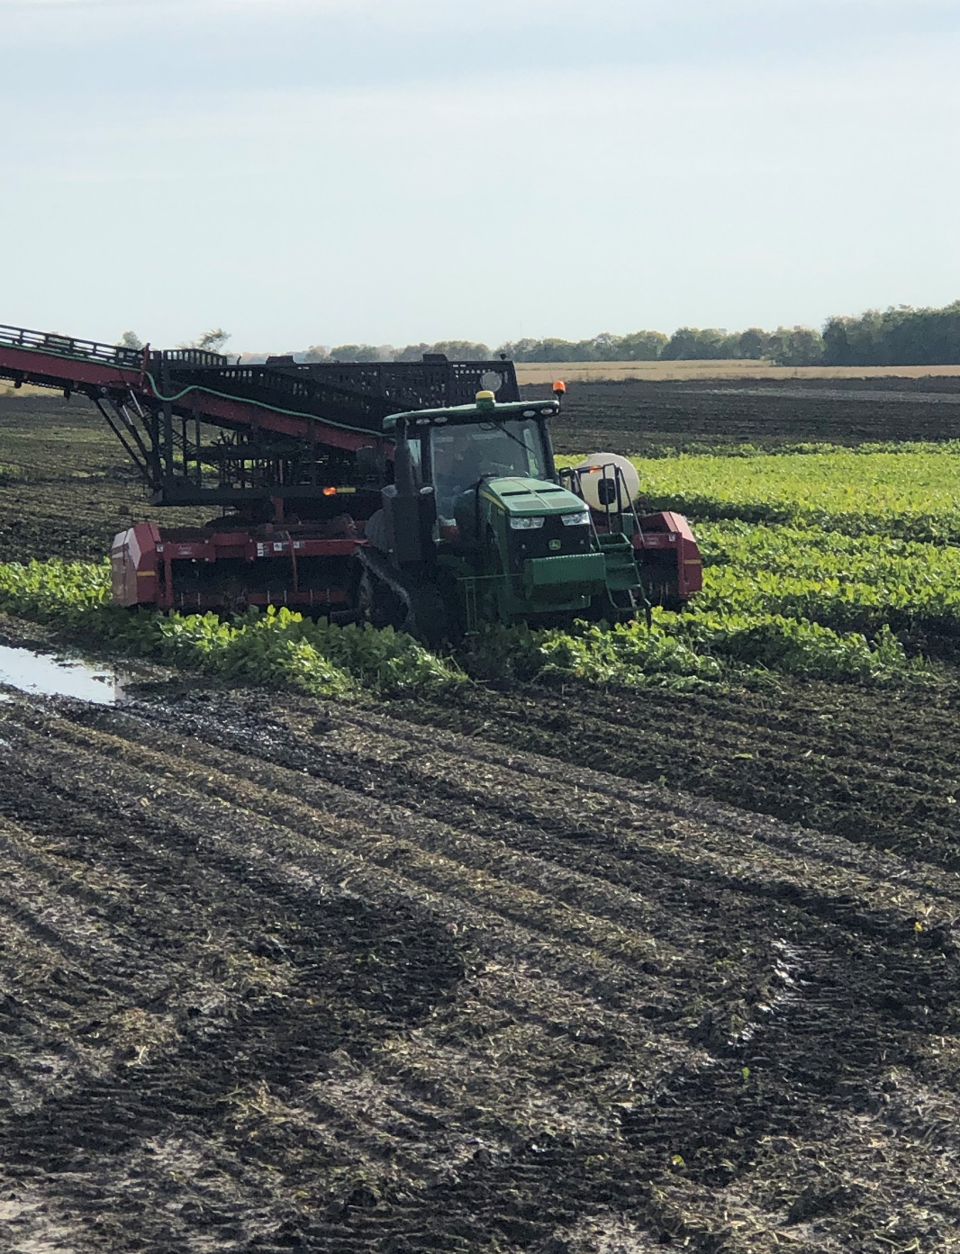
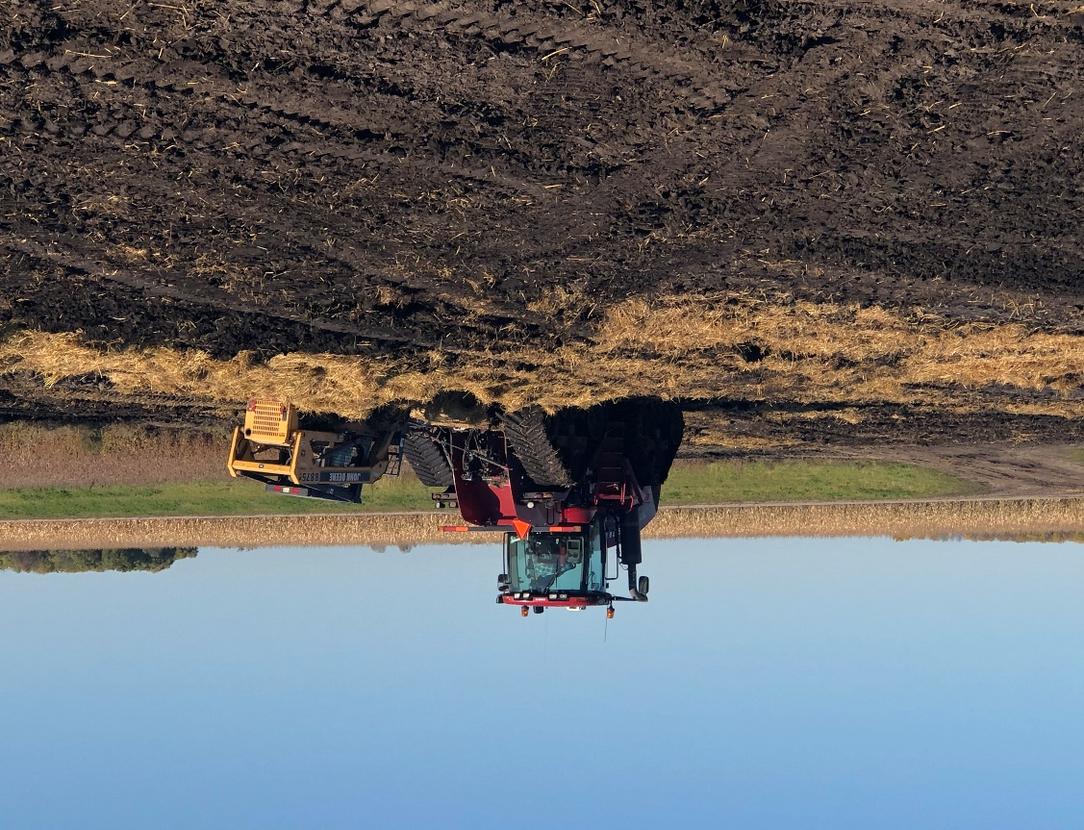
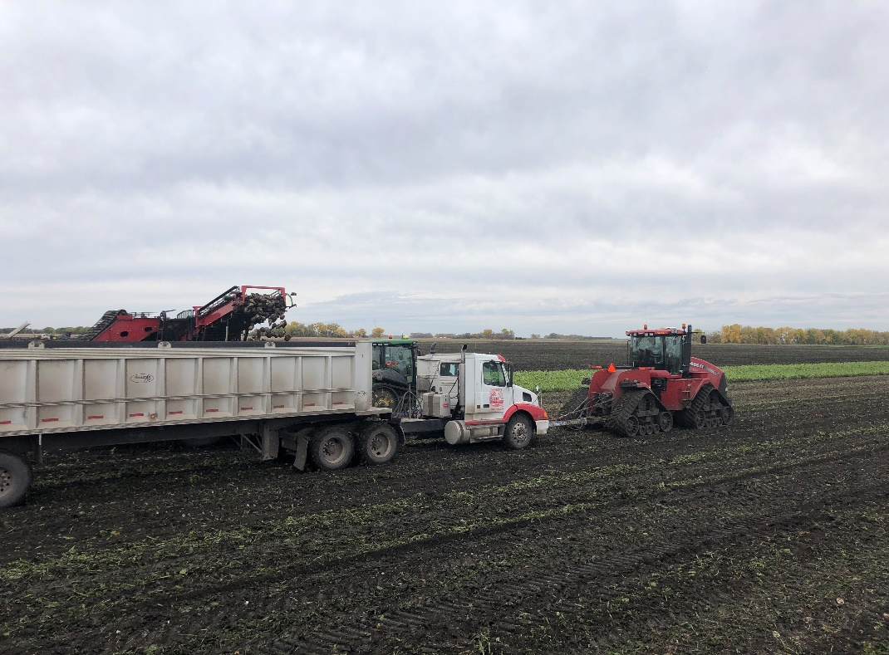
2019 Sugar Beet Harvest
Near Ada, MN

Slide 29
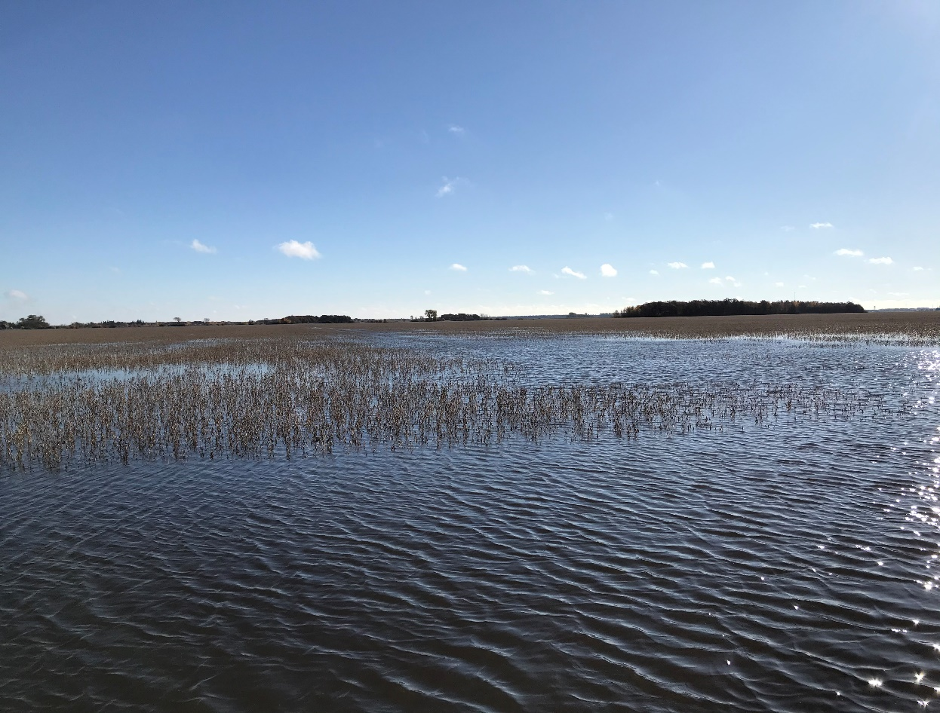
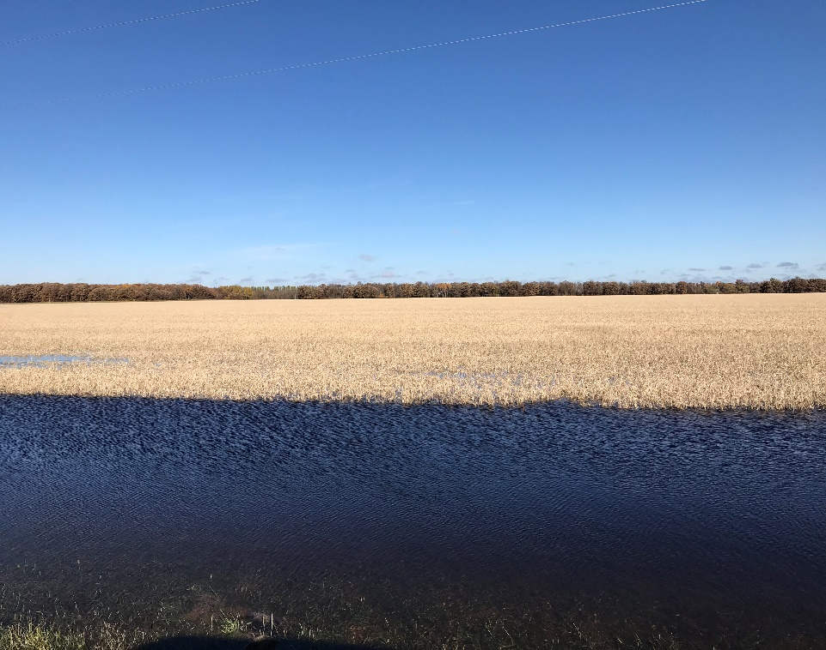
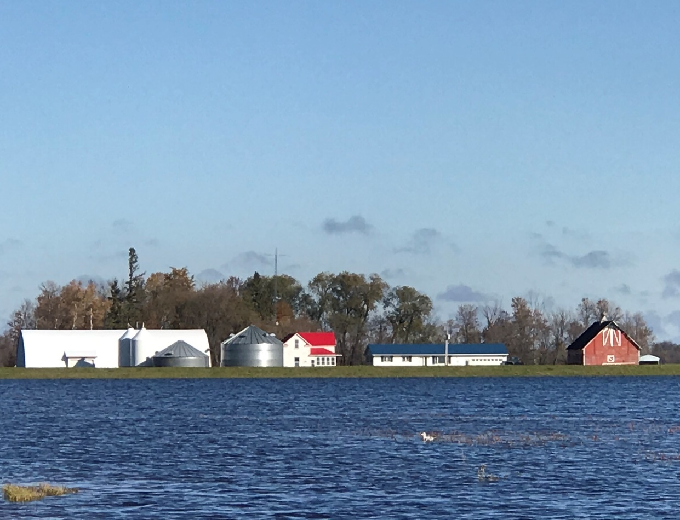
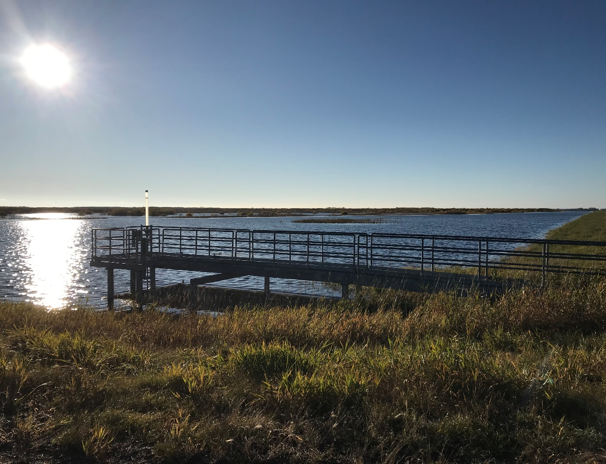
October 17, 2019
Roseau River Watershed District

Slide 30
Current Issues
Major 2019 Crop Losses in the Red River Basin:
Estimated $45 Million Potato Crop Loss Alone
115,000 Sugar Beet Acres not Harvested in Red River Basin
Critical Need to Protect Agricultural Lands and Public/Private Infrastructure Along With Transportation and Drainage Systems
Estimated $293 Million in Project Needs Through Flood Hazard Mitigation Program
DNR Flood Hazard Mitigation Program Request for 2020 - $20 Million
2020 Spring Conditions are not Looking Favorable

Slide 31
Red River Basin Needs
Bonding Dollars for Flood Mitigation Projects
Ring Dike Funds for Farmsteads
Assessment of Flood Water Storage on State Lands
Assurance From State Agencies on Natural Resources Enhancements (NREs) – Amount, Type, Location, and Potential NRE Trading Program
Increased Funding for BWSR Multipurpose Drainage Water Management Grant
Funding for Water Quality Monitoring of Flood Impoundments
Mapping of 10 and 25-year Storm Events for Agricultural Lands
Increased Funding for the 1998 Red River Basin Mediation Agreement

Slide 32
Moving Forward
Creating Partnerships and Leveraging of Resources
NREs – Water Quality and Habitat
Other Benefits to Society in the RRB
Sustainability of RRB Resources – Climate Change
Meeting Goals of Other Plans – Efficiency

Slide 33
Contact Information: Robert L. Sip Executive Director Red River Watershed Management Board Office Address: 11 5Th Avenue East, Suite B Ada, MN 56510 rob.sip@rrwmb.org www.rrwmb.org https://www.facebook.com/RedRiverWatershedManagementBoard 218-474-1084 (Cell) 218-784-9501 (Office) 218-784-9502 (Fax)

